Slide 1
Final Project Proposal
Team 11
Amazon Reviews

Slide 2
About The Dataset –Amazon Reviews
This dataset consists of reviews from amazon
The data span a period of 18 years, including ~35 million reviews up to March 2013
Reviews include product and user information, ratings, and a plaintext review.
There are reviews on products & services provided by amazon ranging from books to softwares ;pet supply to clothing accessories; Gourmet foods to Movie & TV reviews

Slide 3
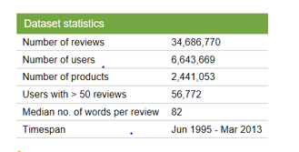
11 GB of Data !

Slide 4
Our Approach
Downloading & Parsing the data which is present in JSON format
Cleaning the Data & Extracting the Reviews
Feature Extraction(The features, such as bag-of-words and bigrams, are compared to one another in correctly tagging reviews)
Classification using techniques such as Naive Bayes and decision list classiﬁers to tag a given review as positive or negative

Slide 5
Our Approach
Deep learning Techniques like Word2vec & Recursive Neural networks will be used for sentiment Analysis
We will be trying to get the best results by comparing algorithms including Document Clusturing & specified classification algorithms & deep learning techniques
Pipelining , Versioning & Containerization would follow..
Analysis of the Results

Slide 6


